Slide 1
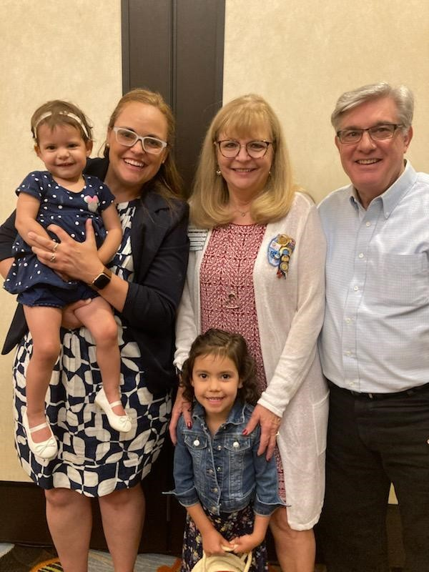


Soroptimist International Truckee Meadows
Year in Review
2024 - 2025
Education is the
of Empowerment
SITM President, Jeanne Naccarato

Slide 2
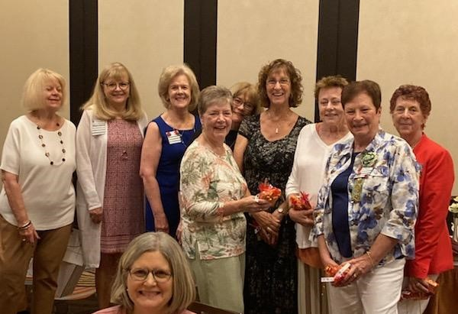
Installation of New Officers

Slide 3
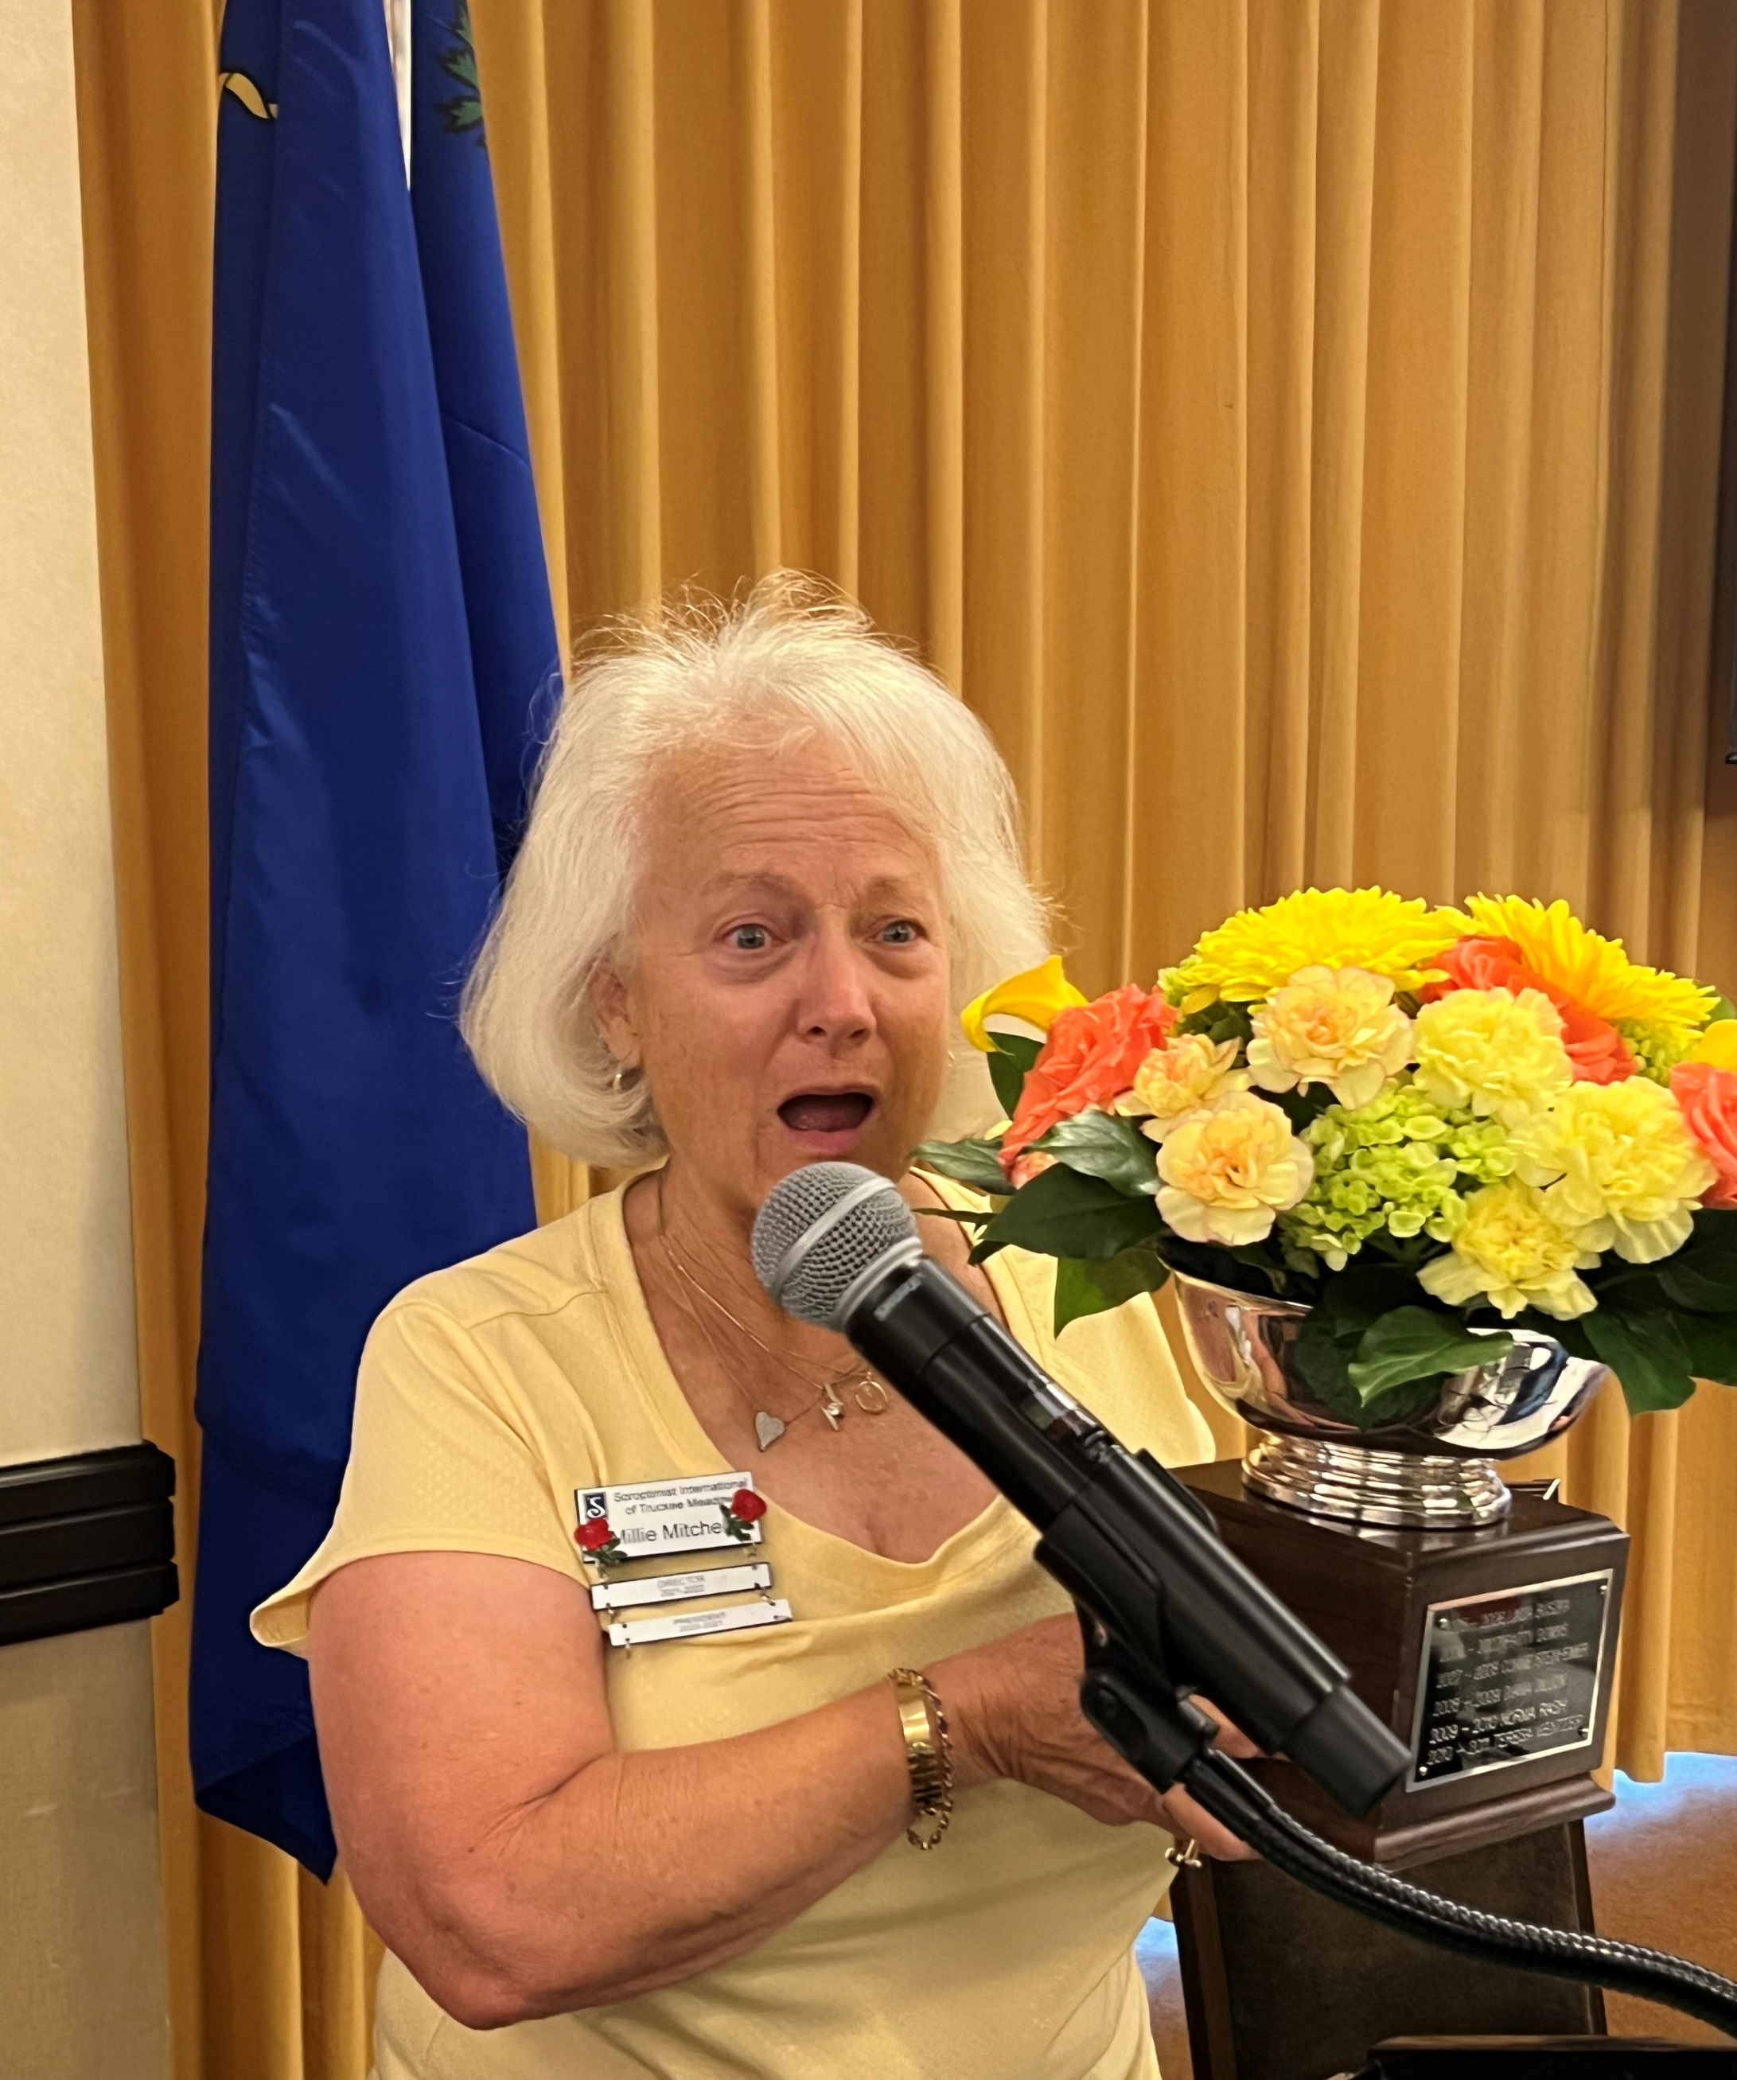
Ceec Abrahams Award 2024, Millie Mitchell

Slide 4
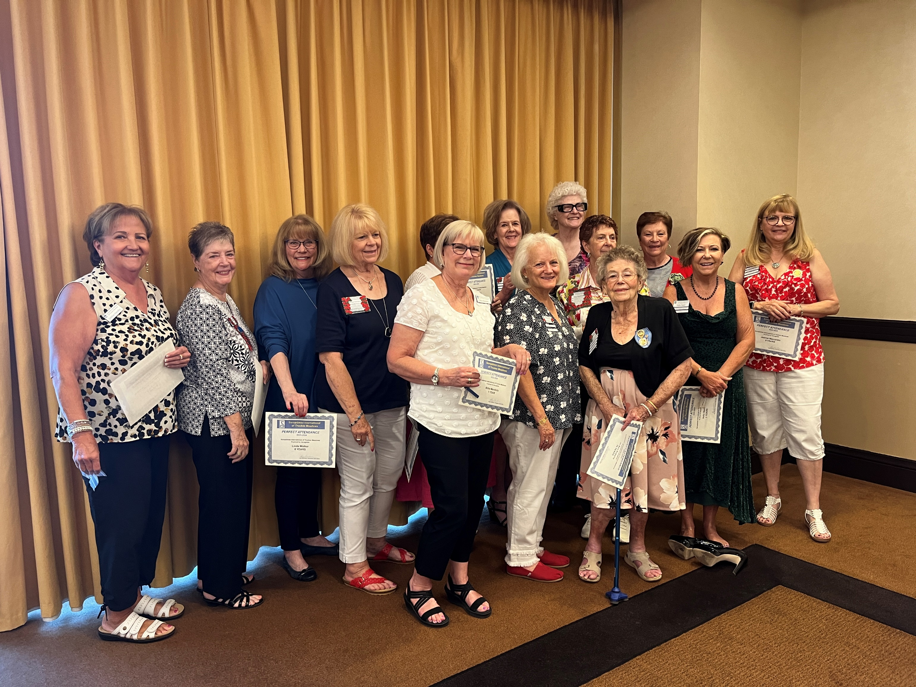
Perfect Attendance
2023 - 2024

Slide 5
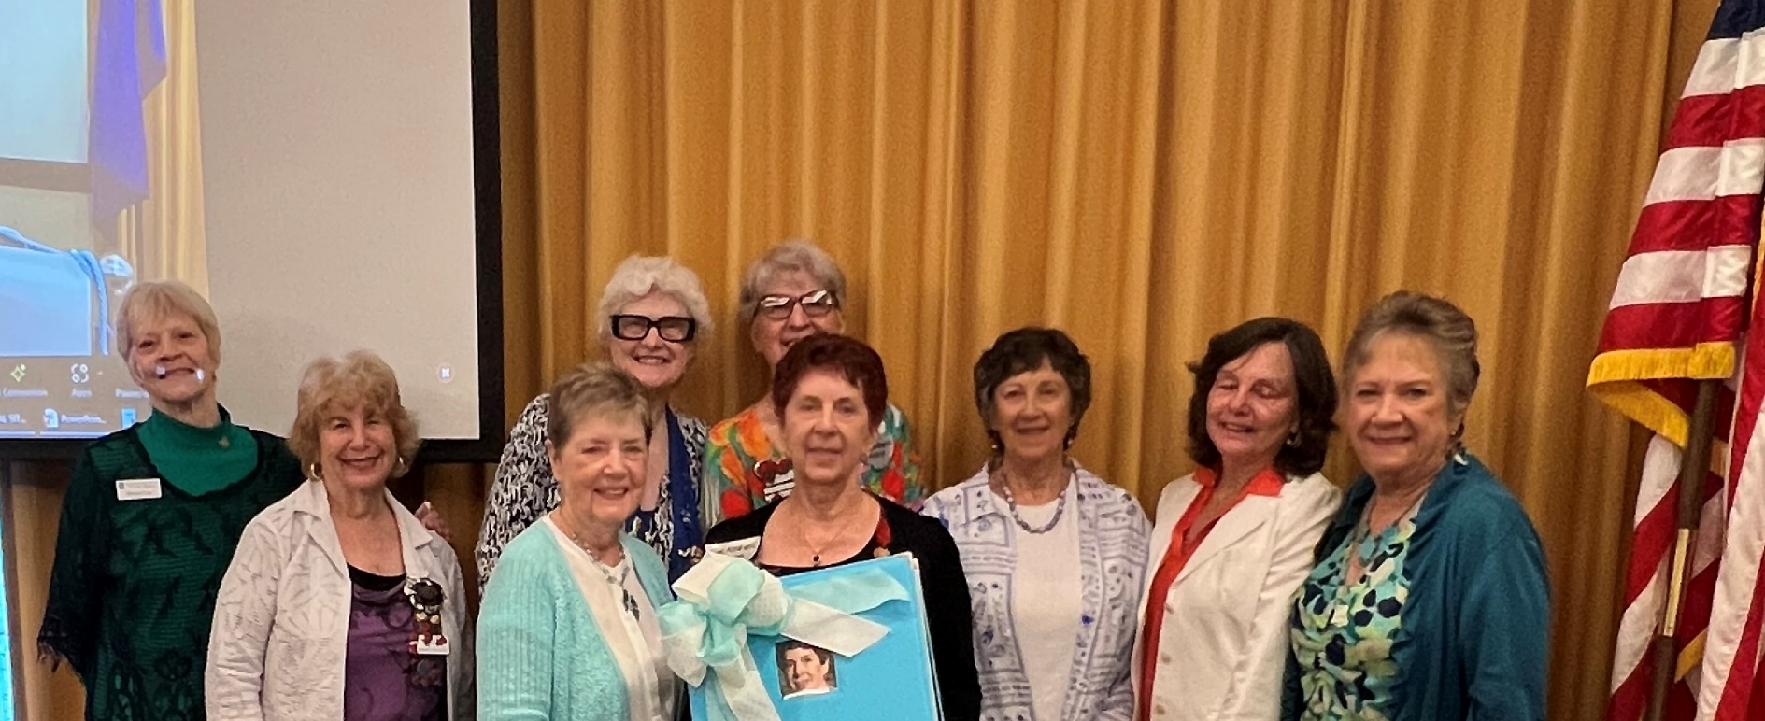
President’s Scrapbook, June 2024

Slide 6
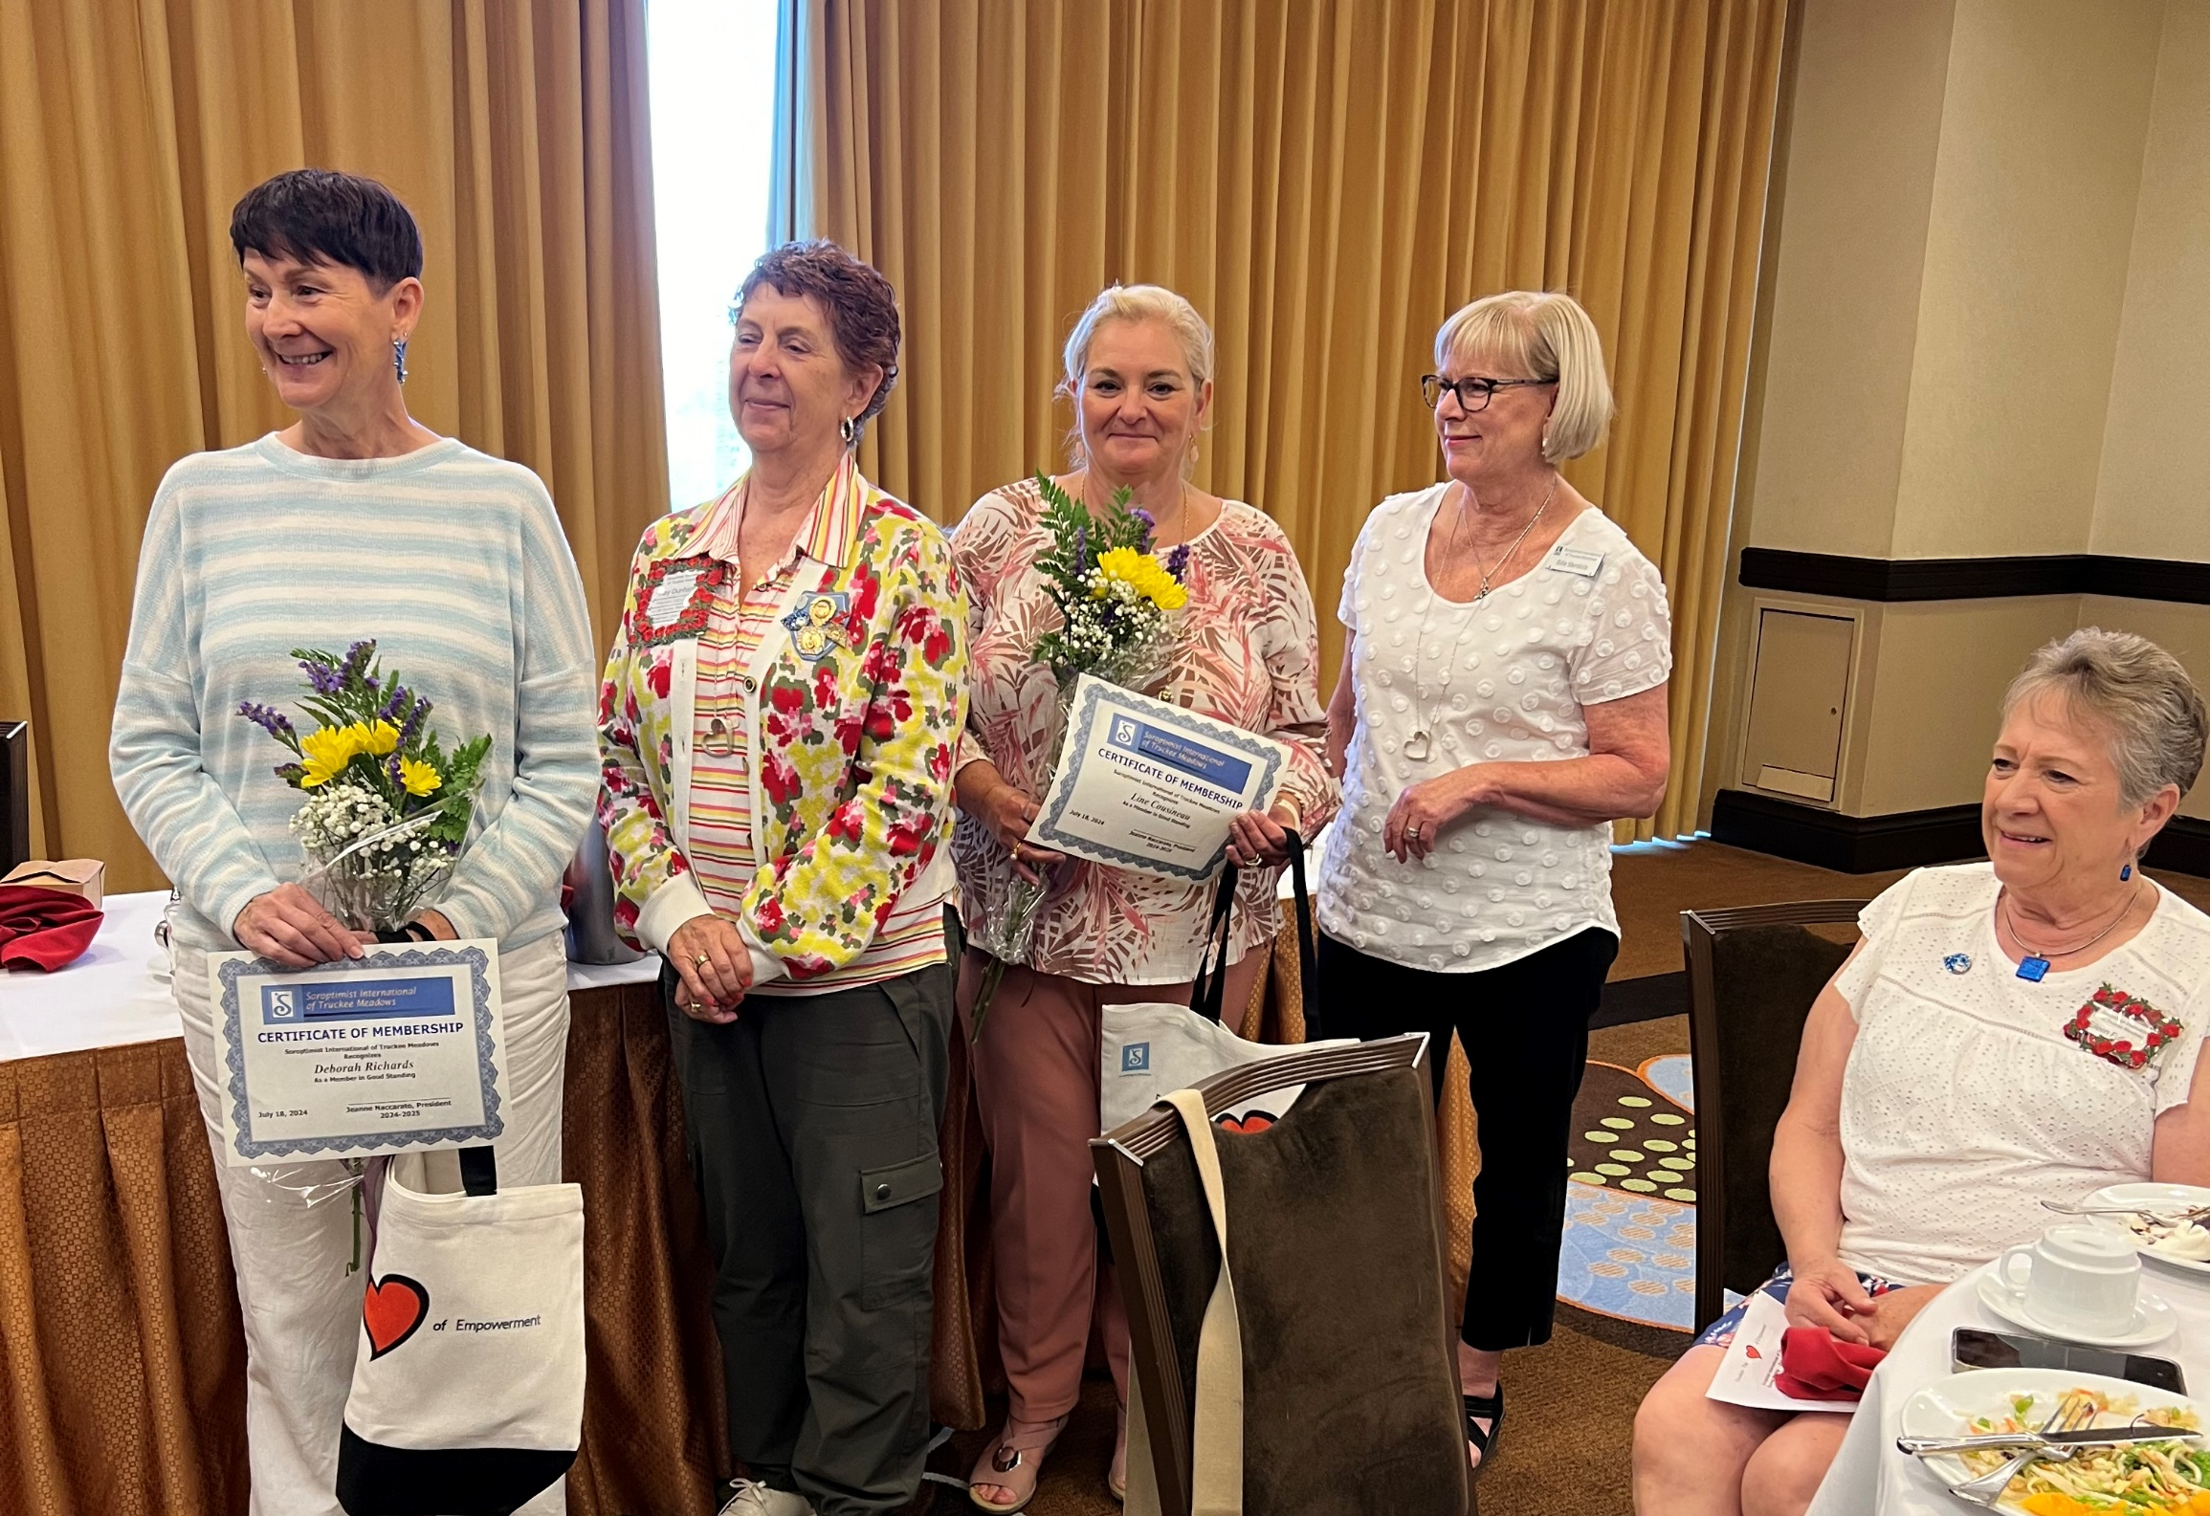
Welcome New Members!
Debbie and Line

Slide 7
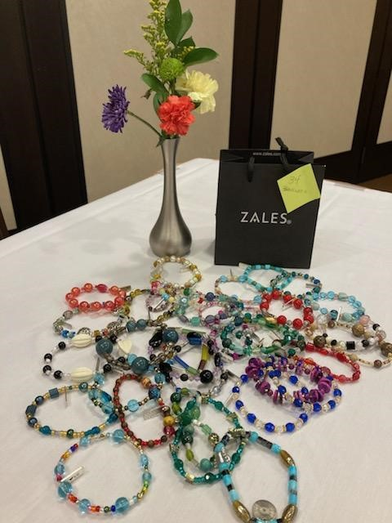
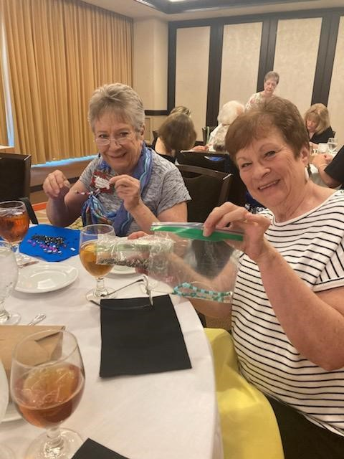
Members Craft Beads of Strength for Infusion Patients

Slide 8
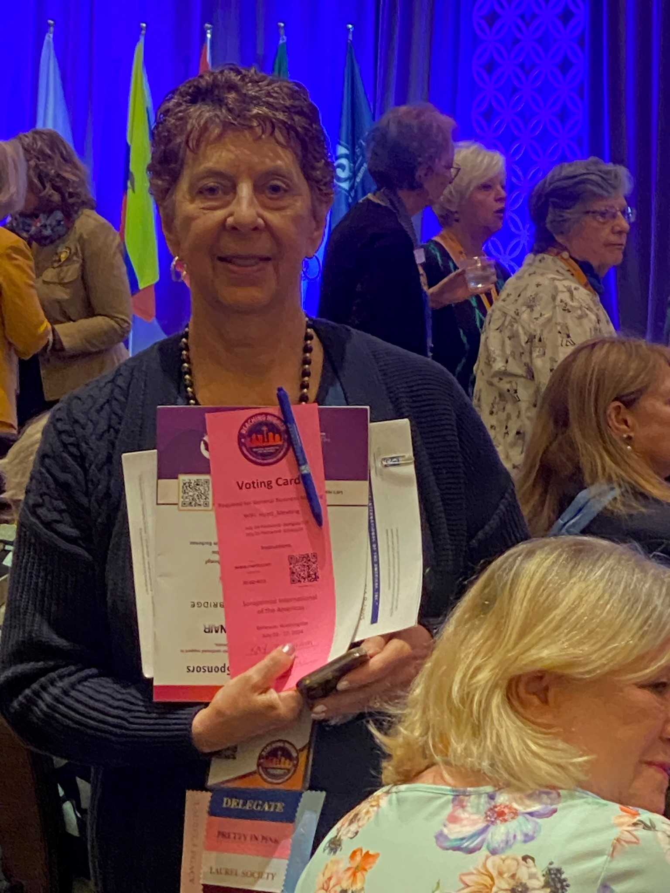

SIA 48th Annual Convention
Delegate
Kay Dunham

Slide 9
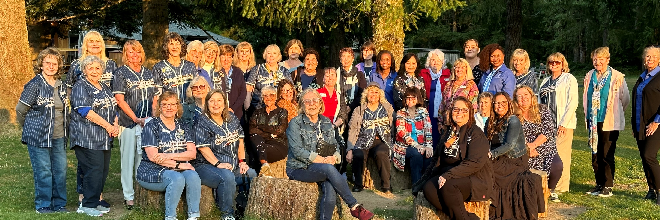
Sierra Nevada Region Gathers for A Night Out

Slide 10
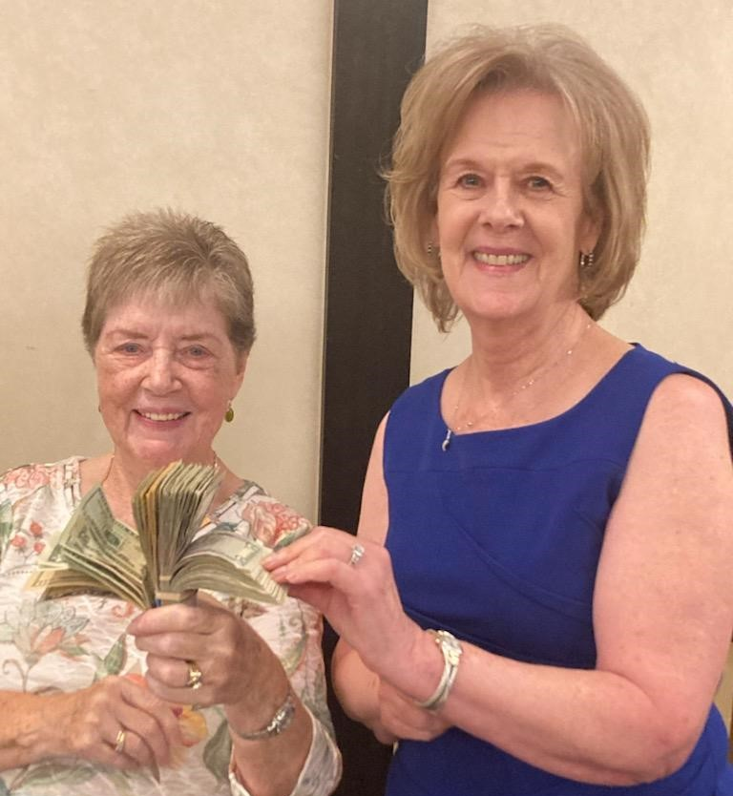
Parking Lot Sale Donation

Slide 11
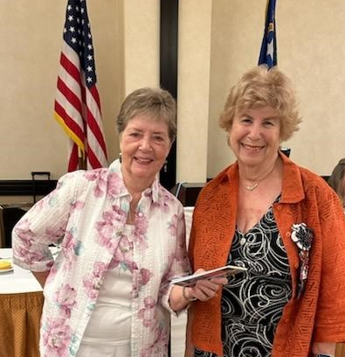

UpliftHER, New Soroptimist Initiative

Slide 12
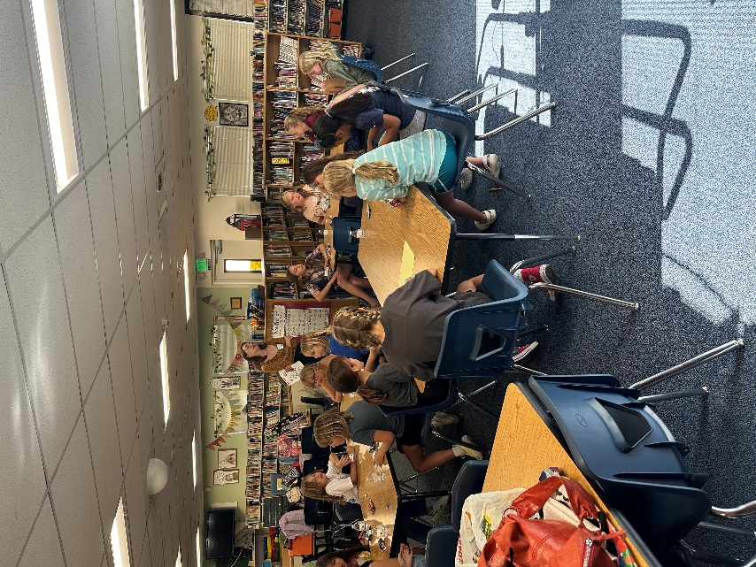
SITM Dream It, Be It
STEAM At Hunter Lake Elementary School Exploring Science, Technology, Engineering, Art, and Math Careers

Slide 13
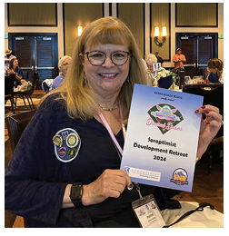
Soroptimist Development Retreat
“ Every seminar was packed with valuable information and the sharing between soroptimists was incredible.”
-President Jeanne Naccarato

Slide 14
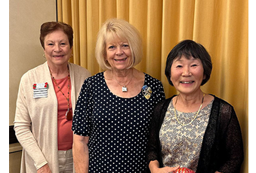
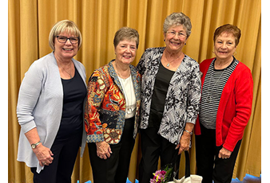
Welcome New Members, Cynthia and Carol

Slide 15
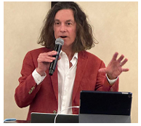
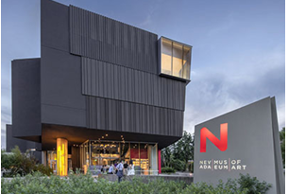
Guest Speaker
David Walker
CEO of the Nevada Museum of Art
Nevada Museum of Art Expansion

Slide 16
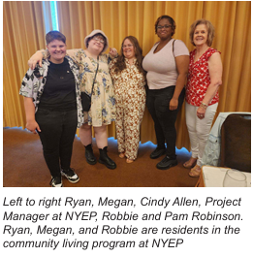
NYEP Fosters Community for At
Risk Young Women

Slide 17
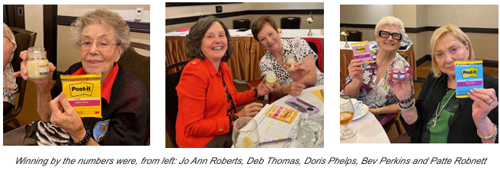
Getting to Know Members

Slide 18
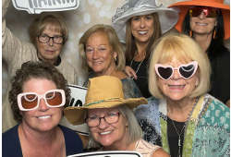
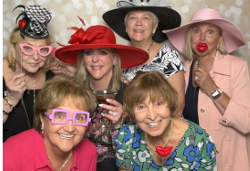
Queen of Hearts High Tea
The club raised around $20,000 for our programs and club activities.

Slide 19
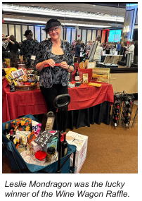
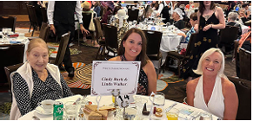
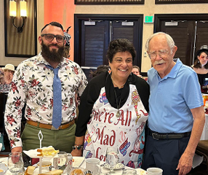
Queen of Hearts
High Tea

Slide 20
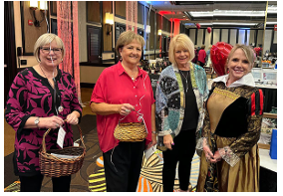
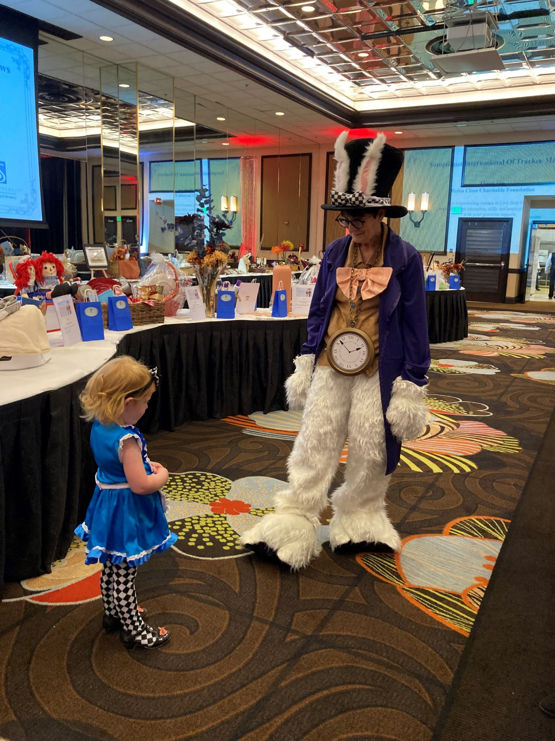
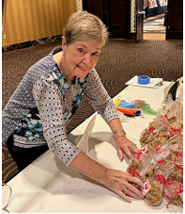
Queen of Hearts
High Tea

Slide 21
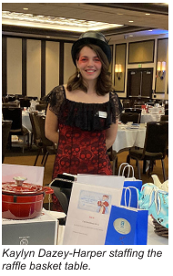
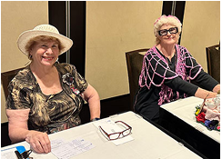
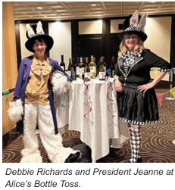
Queen of Hearts High Tea

Slide 22
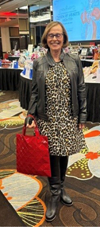
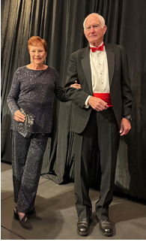
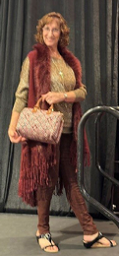
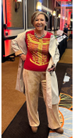
Queen of Hearts High Tea Fashion Show

Slide 23
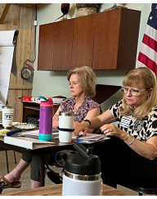
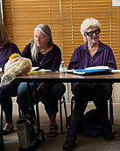
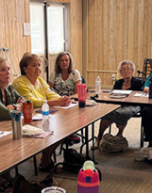
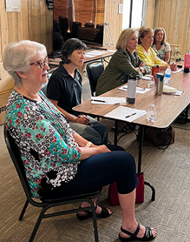
SITM Club Retreat

Slide 24
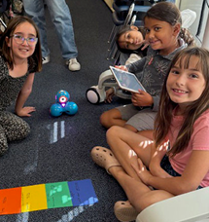
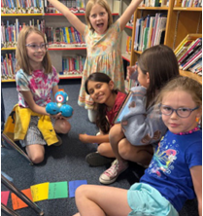
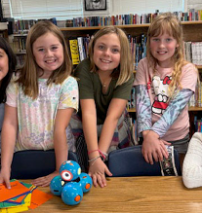
Coding Time for Hunter Lake Girls (STEAM)

Slide 25
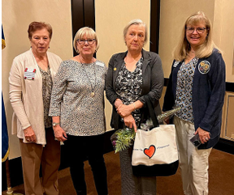
Welcome New Member, Michelle

Slide 26
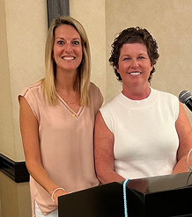
Guest Speakers, Lauren Tegins and Jen Campbell from Awaken

Slide 27
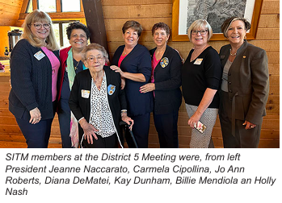
District 5 Fall Meeting

Slide 28
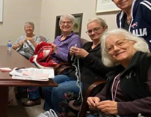
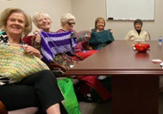
Crochet Social
Benefiting Project 150

Slide 29
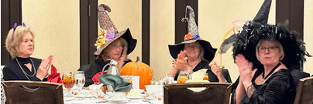
Halloween Social

Slide 30
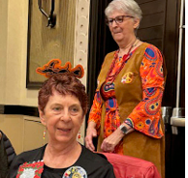
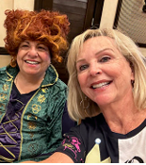


Halloween Fun!

Slide 31


SITM Volunteers, Project 150

Slide 32


SITM Gifts Donated to the Empowerment Center
The Empowerment Center Offers Sober Treatments, Permanent Solutions

Slide 33



Life Skills and Self-Confidence at NYEP During the Holidays

Slide 34

Welcome New Members, Laurie, Mary, and Leca

Slide 35

Happy Holidays from the 2024 – 2026 Sierra Nevada Region Board

Slide 36



STEAM Holiday Party, Decorating Cookies!

Slide 37


Holiday Fundraiser!

Slide 38



Holiday Social and Bake Sale

Slide 39

Sock Donation to Project 150

Slide 40

Welcome New Member, Tessita

Slide 41


Live Your Dream Recipients

Slide 42


SITM Valentine’s Day at NYEP

Slide 43

Welcome New Member, Catherine

Slide 44




SITM Crochet Social!

Slide 45



SITM Donates to Project 150, Sock and Afghans

Slide 46

SITM Walking for Women 2025, Celebrating National Women’s History Month

Slide 47


District 5 Meeting on Women’s History Day

Slide 48




Happy Easter Social!

Slide 49

SITM Filled 200+ Bags of Candy for Project 150

Slide 50


SI/Sierra Reno EMPOWER HER Luncheon

Slide 51

Thanks to Youth Scholars
Seven scholarship recipients were honored and received $2,000 scholarships.

Slide 52


Thanks to Youth Luncheon
With more than 200 in attendance, President Jeanne spoke about Soroptimist and our SITM projects.

Slide 53

An Unsung Hero’s Answer to Bullying and a Shopping Spree!
Dahlia D’Andrea, and a group of her classmates have worked tirelessly with school custodians to take a closet used for storage and create “The Rewind Shack”, Depoali Middle School’s free-cycle thrift store.

Slide 54



After School STEAM Program Still Going Strong

Slide 55





Scrapbook in the Making, for President Jeanne!

Slide 56




SITM Parking Lot Sale!

Slide 57




So Much Fun Raising Funds for the Club!

Slide 58

SITM Women’s Scholarships

Slide 59




SNR Conference, 49 Years

Slide 60





SNR Conference, 49 years!

Slide 61

Welcome New Member, Catherine

Slide 62




Nevada Museum of Art Tour

Slide 63



STEAM, End of Year Party!

Slide 64

SITM Club Highlights
EmpoweHer Fundraiser for Girls in Thulipokhari, Nepal
Membership Committee Recruitment Recognition
Women’s Scholarship Awards
Thanks to Youth Scholarship Awards
Live Your Dream Awards
Ceec Abrahams Award
SITM Perfect Attendance Awards
Every Member Retreat
Scrapbook Committee
Queen of Hearts High Tea
Development Retreat
Community Outreach, Afghans, Clothing, and Hygiene
Community Outreach, Beads of Strength
Community Education for Club Members
Dream It, Be It at Hunter Lake Elementary School
Science, Technology, Engineering, Art, and Math (STEAM) Awareness
SoroptiFUN & Holiday Socials

Slide 65




Slide 66



Through the years Jo Ann engaged in many volunteer and appointed community positions, serving on the State Board for March of Dimes, the City of Reno Task Force on Affordable Housing and the Nevada Self Employment Trust, developing the state’s first micro-lending fund. The City of Sparks appointed her for an eight-year term on the city’s Civil Service Commission.
She was an early inductee into the Nevada Women’s Fund Hall of Fame; was named a Soroptimist Woman of Distinction; received the Hannah Humanitarian Award from the Committee to Aid Women; and was a Sparks High School Outstanding Alumna.

Slide 67



Jo Ann joined Soroptimist International of Truckee Meadows (SITM) as a charter member in 1978 and remained active throughout her life. She served as SITM’s President from 1983-84. She went on to become Sierra Nevada Region Treasurer for two terms, Governor-Elect and Region Governor from 1990-1992, followed by many years as the Region Archivist.

Slide 68

Speaking of her community service, Jo Ann once said, “The service we provide in our communities is the rent we pay for our place on earth.”

Slide 69
A Very Special Thank You to Faye Anderson for providing the photos used in the PPT, and for providing informative and resourceful SITM newsletters, for the content and creation of this slide show.

